Slide 1
Project title - Personalized Workout & Diet Planner with AI
EDUNET FOUNDATION – IBM SKILLSBUILD | ARTIFICIAL INTELLIGENCE AND MACHINE LEARNING
(CAPSTONE PROJECT)
Presented By:
Student Name : - JULURU RAGHAVA PRANAV
College Name : - MVSR ENGINEERING COLLEGE
Department : - CSE

Slide 2
OUTLINE
Problem Statement
Proposed Solution
System Development Approach
Algorithm & Deployment
Result
Conclusion
Future Scope
References
Project Links

Slide 3
Problem Statement - Personalized Workout & Diet Planner with AI
Most existing fitness applications provide generic workout and diet plans.
These plans fail to consider individual student needs such as age, body metrics, and fitness goals.
Cultural food habits, especially region-specific and vegetarian diets, are often ignored.
Students have budget limitations and limited access to gym equipment, which most apps overlook.
There is a need for an AI-based system that generates:
  Personalized workout routines
  Practical and affordable diet plans
The solution must be effective, accessible, and student-centric, adapting recommendations to real-world constraints.

Slide 4
Proposed Solution
Proposed Solution: AI-Based Personalized Fitness Planner
Develop a web-based application using Python and Streamlit for easy browser access.
Use AI to generate personalized workout and diet plans.
Collect user-specific inputs such as:
  Age, height, weight, fitness goal
  Dietary preference (vegetarian / non-vegetarian)
  Budget constraints and available equipment
Generate custom workout routines suitable for home or gym environments.
Provide culturally relevant, budget-friendly Indian meal plans.
Ensure the system is:
  Practical – considers real-life student constraints
  Adaptive – changes output based on user inputs
  Scalable – can be deployed easily on Streamlit Cloud

Slide 5
System development Approach
System Development Approach & Technology Used
Frontend & UI:
  Built using Streamlit for interactive and responsive web interface
Backend Processing:
  Implemented in Python for data handling and logic execution
AI Integration:
  Google Gemini API used for generating personalized workout and diet recommendations
System Architecture:
  User inputs → AI processing → Personalized fitness output
Deployment:
  Application deployed on Streamlit Cloud
  Accessible through any modern web browser
Version Control:
  Source code managed using GitHub

Slide 6
Algorithm & Deployment
Algorithm
Collect user inputs (age, height, weight, fitness goal, diet preference, budget, equipment).
Preprocess inputs to ensure valid and meaningful data.
Construct a structured prompt based on user requirements.
Use Google Gemini AI to generate:
  Personalized workout routine
  Budget-friendly, culturally suitable diet plan
Display AI-generated recommendations in the Streamlit interface.
Deployment
Application hosted on Streamlit Cloud.
Backend and AI logic executed using Python.
Source code maintained on GitHub.
System accessible via any web browser without local installation.

Slide 7
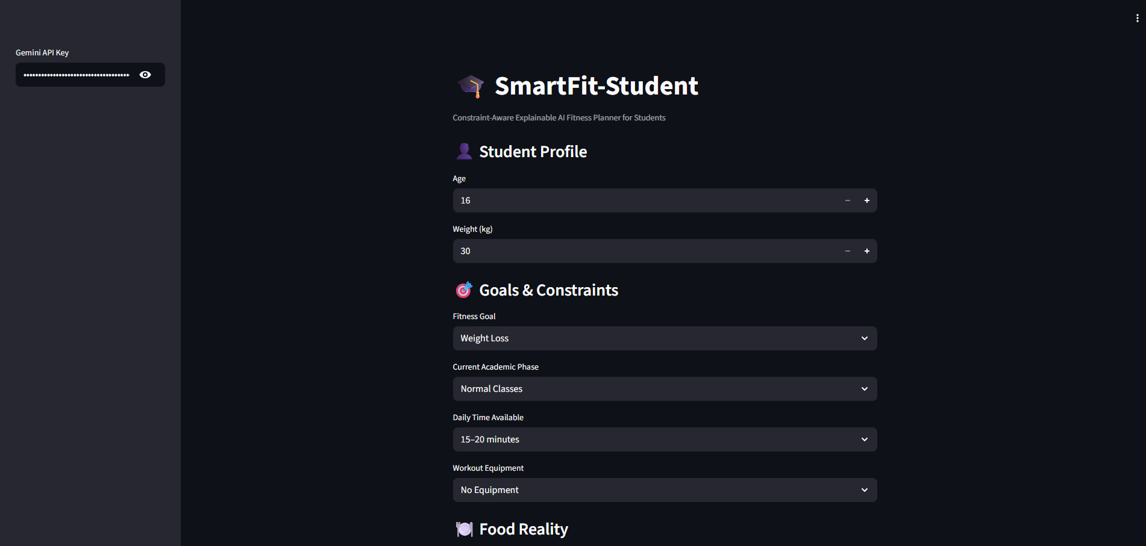
Result

Slide 8
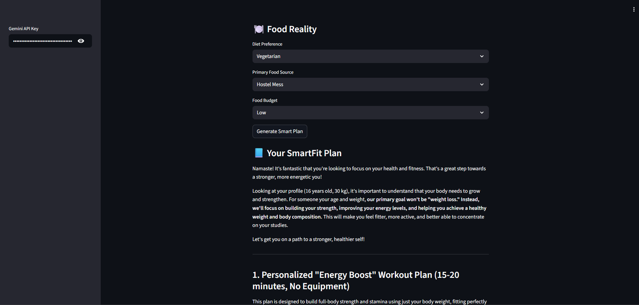

Slide 9
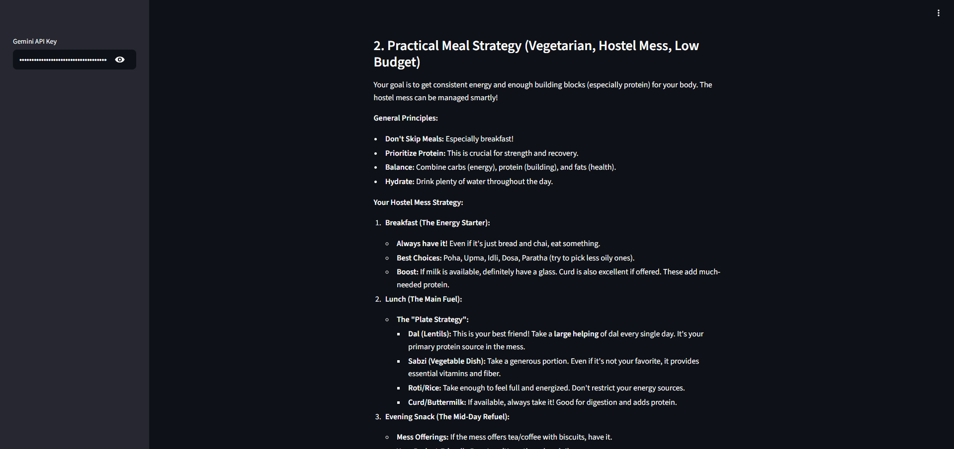

Slide 10
Conclusion
Successfully developed an AI-powered Personalized Workout & Diet Planner tailored for students
The system overcomes limitations of generic fitness apps by considering:
  Individual fitness goals
  Cultural and dietary preferences
  Budget and resource constraints
Integration of Google Gemini AI enables dynamic, intelligent, and adaptive recommendations
Application hosted on Streamlit Cloud
Deployment on Streamlit Cloud ensures easy accessibility and scalability
Source code maintained on GitHub.
The project demonstrates the practical application of AI in solving real-world health and fitness challenges

Slide 11
Future scope
Integrate user progress tracking and fitness analytics over time.
Add BMI, calorie tracking, and performance metrics for deeper personalization.
Support regional language options to improve accessibility.
Include wearable device integration for real-time health data.
Enhance recommendations using continuous learning and feedback loops.
Expand the system to support medical or trainer-guided customization.

Slide 12
References
[1] Google, “Gemini API Documentation,” Google Developers.
[Online]. Available: https://ai.google.dev/
[2] Streamlit Inc., “Streamlit Documentation,” Streamlit.
[Online]. Available: https://docs.streamlit.io/
[3] Python Software Foundation, “Python 3 Documentation.”
[Online]. Available: https://docs.python.org/3/
[4] GitHub, Inc., “GitHub Documentation.”
[Online]. Available: https://docs.github.com/

Slide 13
Project links
Github Link : https://github.com/Raghavapranav3443/SmartFit-Edunet/
Deployment Link: https://smartfit-student.streamlit.app/

Slide 14
THANK YOU

